Slide 1


Slide 2

Welcome Back!
Notes:
Music playing prior to start
Brady & Brendon – welcome back

Slide 3

Panel 1: Light Gray Group Panel 2: Dark Gray Group Panel 3: Green Group
Stopwatch
Panel Discussions
Stick around after the panels
for a group picture!
Notes:
Brady & Brendon to explain Panel activity

Slide 4
Break
Notes:
Robin & Team
Music to close

Slide 5
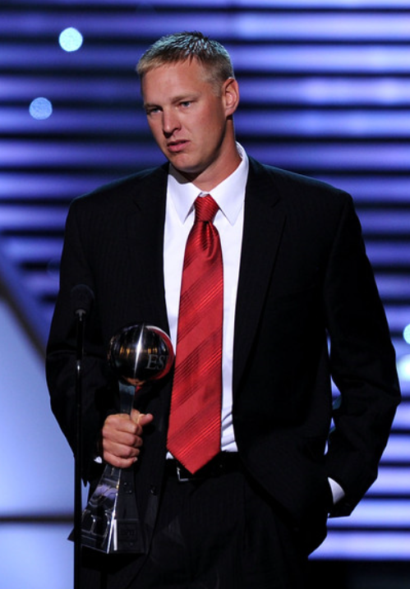
Aaron Thomas
Notes:
Music playing during break
Jade Welcome back from break and introduce Aaron Thomas

Slide 6

How Will You
Notes:
Sammy, Natalie & Andrea to introduce activity

Slide 7
How Will You Rise?
The degree to which you are committed to a goal indicates the likelihood of your achieving it. Commitment – sheer passion and will – can help you overcome any deficiency.
The secret to success is simple. Never quit. Correct and improve always, but never quit.
Please write down what you are committed to on the other side of your plant and work until you achieve it!
Stopwatch

Slide 8
Thank You
Notes:
Robin & Team
Music to close

